Slide 1
Call for Code – COVID crisis communication
Team - Cognizant Innovators
Participants:
Aiswarya Balakrishnan – 166421
Timir Baran Chakraborty - 242628

Slide 2
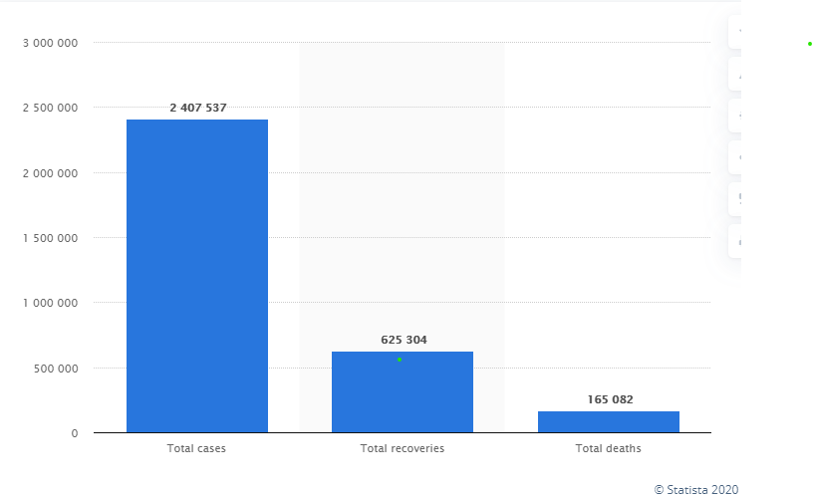
COVID recovery and the life ahead
Early estimates predict that the overall COVID-19 recovery rate is between 97% and 99.75%*
Understand the lingering effects of the virus and the need for continuous assistance post recovery
Collect data to understand health status of
COVID 19 survivors
Prepare for surge in pneumonia, acute respiratory distress syndrome (ARDS), increased risk of future illness including heart attack, stroke & kidney failure cases and physiological assistance
* source: webmd.com

Slide 3








Our approach
Implement a doctor driven approach & patient driven approach to continuously monitor patient health and ensure preparedness
Solution
Enabler
Outcome
1
Individual to be facilitated with an option to use a chat bot to constantly inquire about their health concerns
2
Chat bot to gather their concerns and provide details on identified list of doctors
Facilitate use of chat bots to reach out on their symptoms
3
Provide details on nearest COVID testing center
Better patient engagement and guidance
Recovered individual driven approach
Watson Assistant
To be considered for future implementation beyond the Hackathon
Solution
Enabler
Outcome
1
Doctor facilitated with a voice to text option to request for any symptoms faced by the discharged individual for recommended period of time
2
Individuals stats shared using IOT
Voice to text inquiry to recovered patients periodically to gather vital stats and perform risk assessment
3
Perform risk assessment for every individual based on past data of COVID affected individuals
Better preparedness to enable preventive care
Doctor driven approach
Advance Analytics
Risk assessments
Wearables and IoT
Mobility

Slide 4
Technology enablers used for Medical chatbot implementation
Technology used for current implementation
Technology that will be used for future implementation
IBM Watson assistant
IBM Watson assistant
IBM Cloud
IBM Cloud
JSON
JSON
Python
IoT

